Slide 1

DISEASE RISK PREDICTION
Machine learning approach for disease prediction
Presented by:
Amala Joseph

Slide 2
OBJECTIVE
To develop a data-driven machine learning model that predicts the likelihood of disease risk based on patient attributes such as age,gender,lifestyle,and health indicators.The model aims to support early diagnosis and assist healthcare professionals in decision-making.
OVERVIEW STEPS
Understanding the problem
Dataset collection and preprocessing
Exploratory data analysis
Model development and evaluation
Model deployment and conclusion

Slide 3
CHOOSING A DATASET
The dataset carefully chosen to include important medical and lifestyle indicators.
It contain features such as;
Age,Gender – to capture demographic factors.
BP,cholesterol,BMI – to represent key health measurements.
Lifestyle factors – such as physical activity,smoking,and diet habits.
These attributes help the machine learning model understand complex patterns and predict disease risk accurately.
The dataset obtained from KAGGLE

Slide 4
TARGET
Disease risk
FEATURES
Age
Gender
BMI
Daily steps
Sleep hours
Water intake
Calories consumed
Smoker
Alcohol
Resting hour
Systolic BP
Diastolic BP
Cholesterol
Family history
Number of rows in the dataset are 13477.

Slide 5
UNDERSTANDING THE PROBLEM
Problem definition
Inaccurate or incomplete understanding of individual health characteristics often leads to delayed diagnosis and poor treatment decisions. This lack of personalized analysis and results in ineffective health management, recurring medical issues ,and increased healthcare costs. There is a need for reliable, data-driven system to accurately predict disease risk and support preventive healthcare decisions.
Importance
Accurate disease risk prediction is essential for early diagnosis ,effective treatment planning and overall public health improvement. It empowers doctors and patients to make informed decisions ,promotes awareness about health factors, and reduces the burden of undetected diseases. It also supports healthcare organizations in optimizing preventive strategies and improving patient outcomes.

Slide 6
DATA PREPROCESSING
Data cleaning: No null values were found on the dataset.
Outlier Treatment: Removed outliers and plotted boxplot after outlier removal.
Data Transformation: LabelEncoder
Label Encoding is a technique used in data preprocessing to convert categorical variables into numerical values. This transformation is essential for machine learning models that require numerical input to perform calculations. It is applied to feature ‘Gender’.
Scaling: Applied StandardScaler for normalization.
Splitting dataset into training and testing sets.

Slide 7
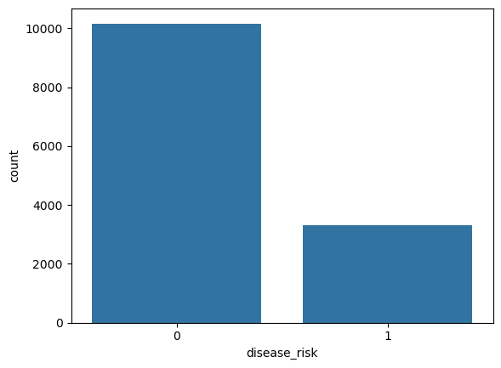
EXPLORATORY DATA ANALYSIS (EDA)
Visualization
Count plot
The countplot shows the distribution of the disease_risk variable.
It indicates that the number of people with no disease risk (0) is significantly higher than those with disease risk (1).
This means the dataset is imbalanced, with more samples in the low-risk category compared to the high-risk category.

Slide 8
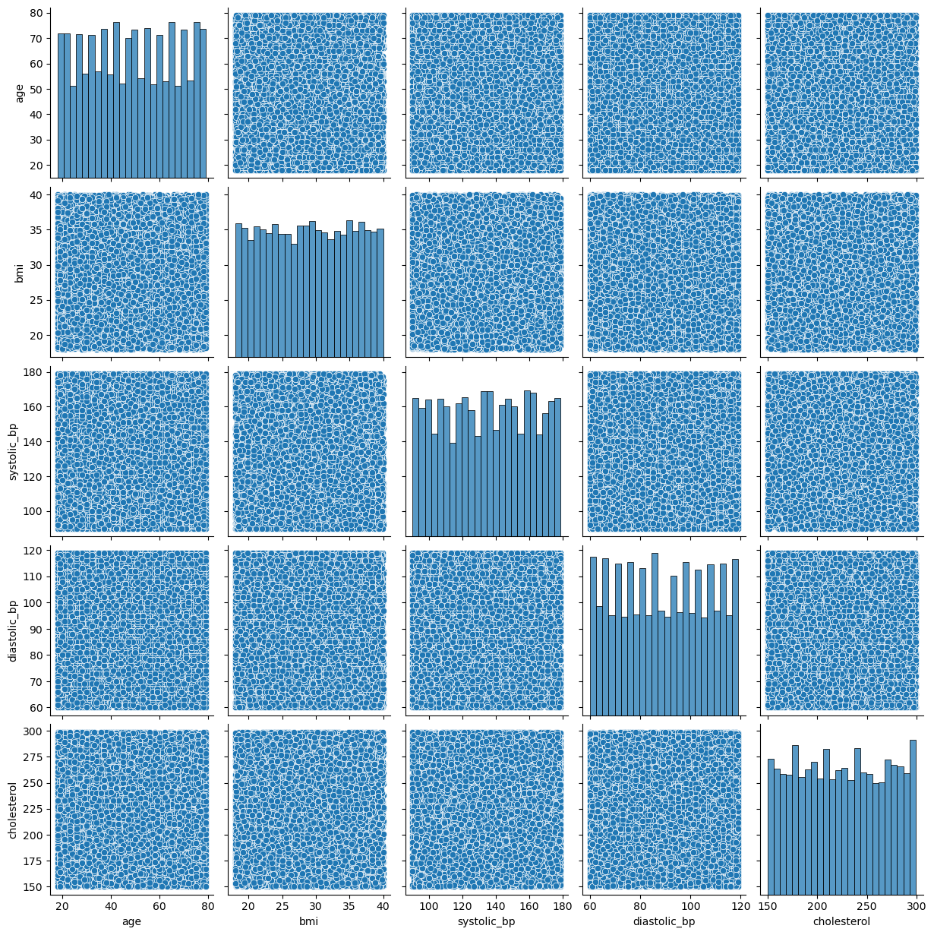
The pairplot shows feature distributions and how health & lifestyle variables relate to each other, helping identify patterns and weak or strong relationships.
Pair plot
The pairplot shows feature distributions and how health & lifestyle variables relate to each other, helping identify patterns and weak or strong relationships.

Slide 9
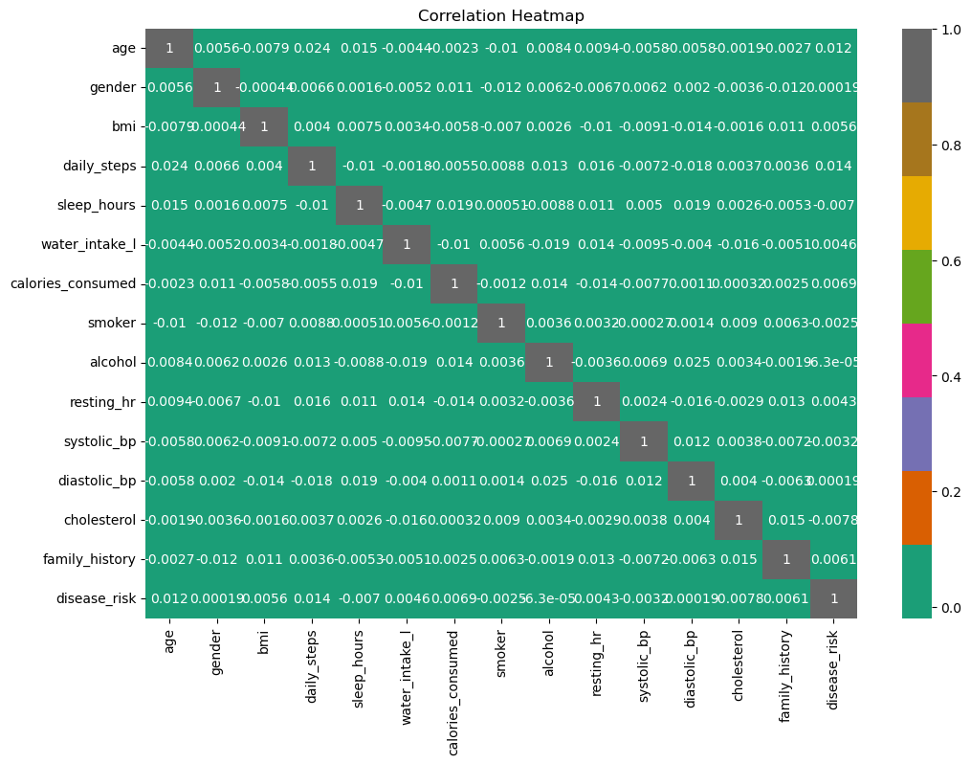
.
Heat Map
Most features are weakly correlated, indicating diverse data. Cholesterol and blood pressure slightly influence disease risk.

Slide 10
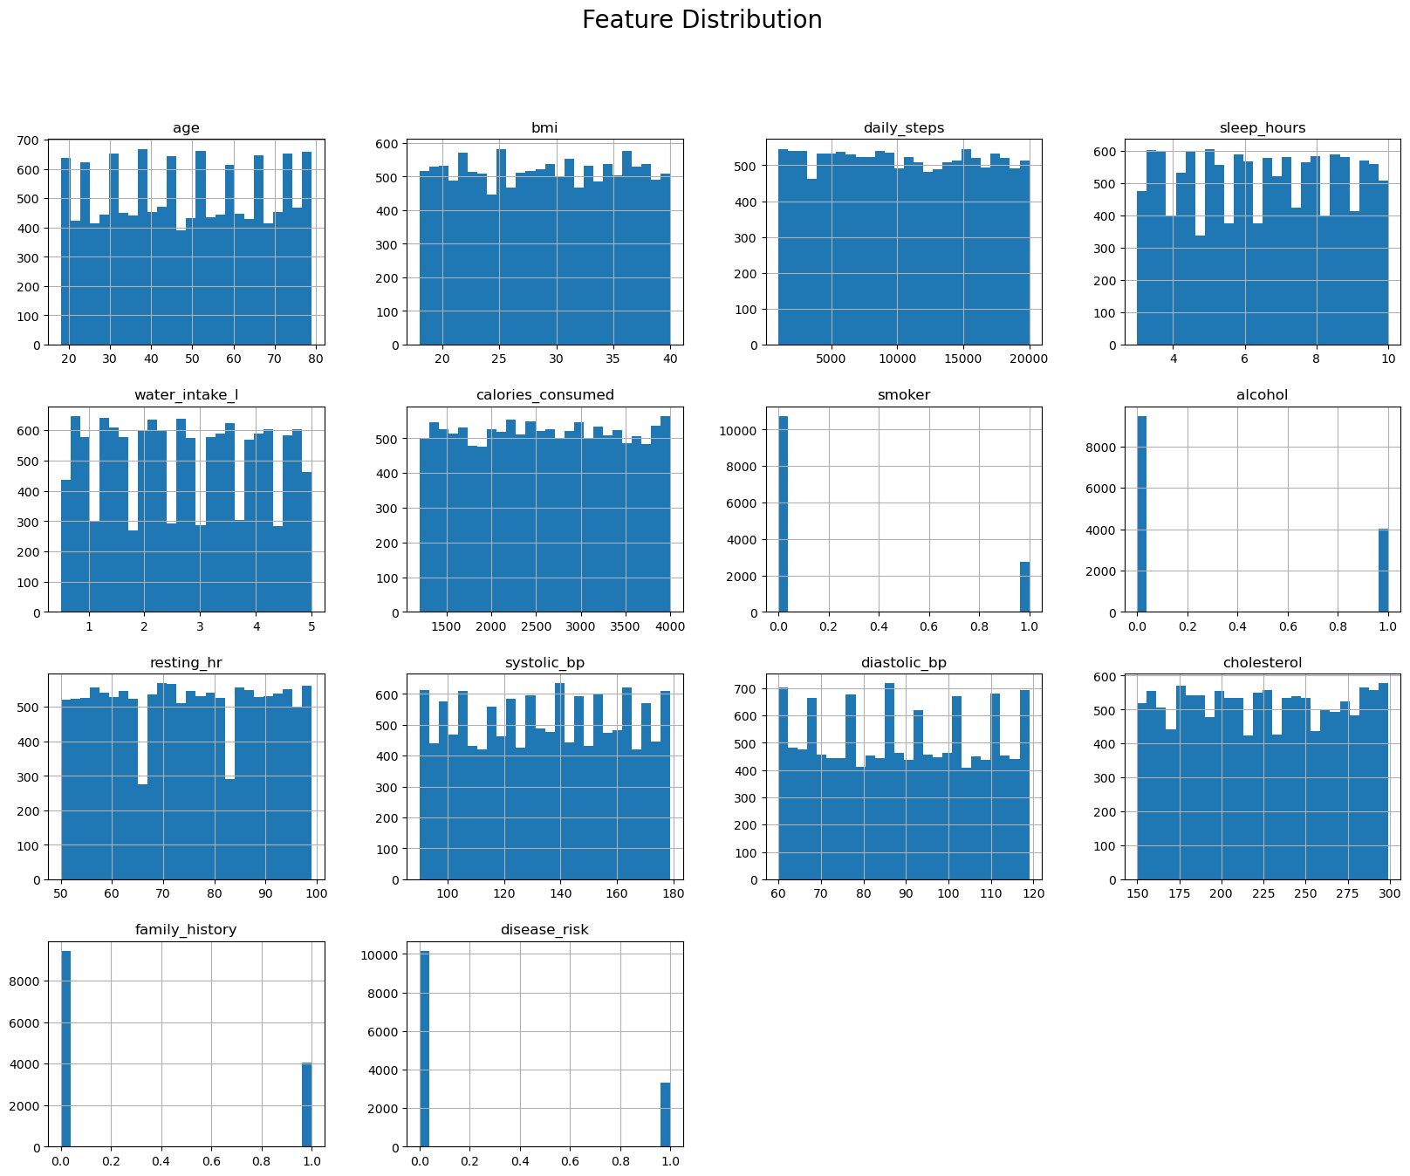
.
Hist plot
Hist plots show how each variable in the dataset is spread across different values.Most continuous features such as age, BMI, blood pressure, cholesterol, and daily steps are fairly evenly distributed. Binary features like smoker, alcohol, and family_history show clear separation between 0 and 1 values

Slide 11
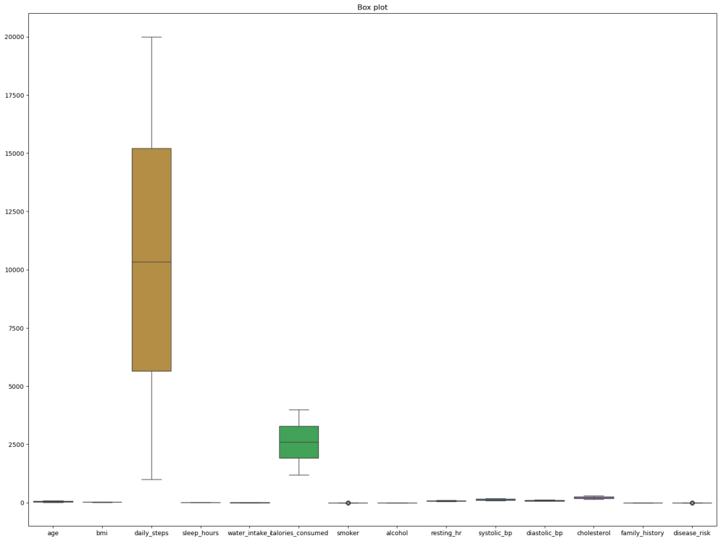
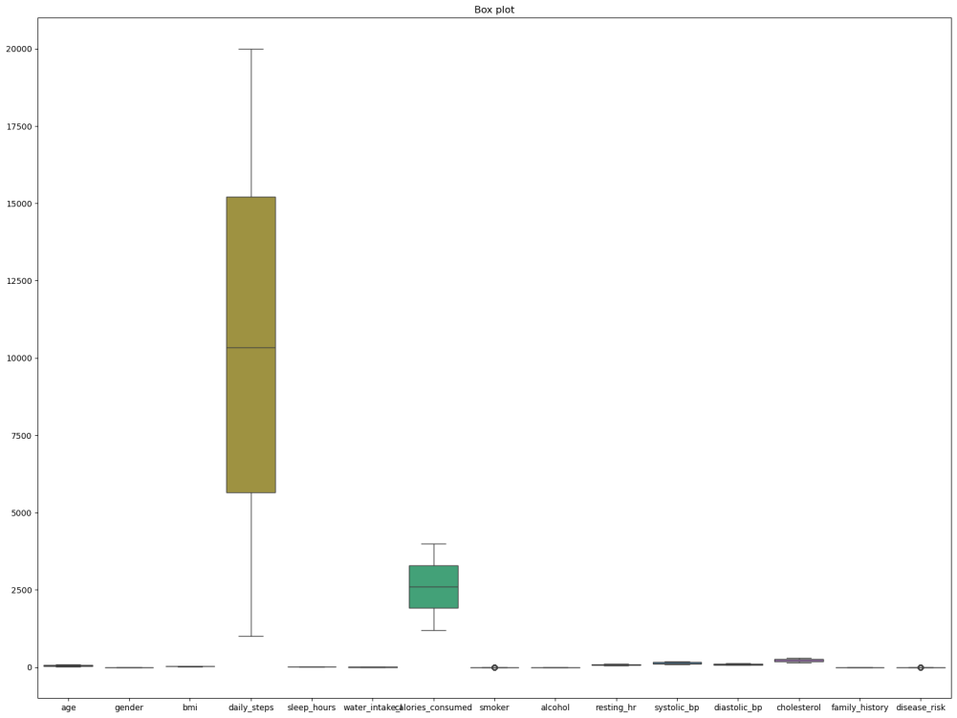
.
Box Plot
Before outlier removal After outlier removal
The box plots display the distribution and outliers of all numerical features.
Before preprocessing, some variables like daily steps and calories consumed showed extreme outliers . After cleaning, the data became more consistent, indicating that outlier removal helped improve data quality and model performance. Before preprocessing, some variables like daily_steps and calories_consumed showed extreme outliers.

Slide 12
Summary Statistics
 | count | mean | Std | min | 25% | 50% | 75% | max
Age | 13477.0 | 48.628330 | 17.882750 | 18.0 | 33.0 | 49.0 | 64.0 | 79.0
BMI | 13477.0 | 29.010084 | 6.369118 | 18.0 | 23.5 | 29.0 | 34.6 | 40.0
Daily steps | 13477.0 | 10428.265638 | 5500.670615 | 1000.0 | 5650.0 | 10332.0 | 15209.0 | 19999.0
Sleep hours | 13477.0 | 6.509245 | 2.030890 | 3.0 | 4.8 | 6.5 | 8.3 | 10.0
Water intakE | 13477.0 | 2.740521 | 1.302781 | 0.5 | 1.6 | 2.7 | 3.9 | 5.0
Calories consumed | 13477.0 | 2601.380055 | 808.542889 | 1200.0 | 1912.0 | 2597.0 | 3292.0 | 3999.0
Smoker | 13477.0 | 0.203235 | 0.402421 | 0.0 | 0.0 | 0.0 | 0.0 | 1.0
Alcohol | 13477.0 | 0.297544 | 0.457195 | 0.0 | 0.0 | 0.0 | 1.0 | 1.0
Resting hr | 13477.0 | 74.559175 | 14.378296 | 50.0 | 62.0 | 75.0 | 87.0 | 99.0
Systolic bp | 13477.0 | 134.650664 | 25.917236 | 90.0 | 112.0 | 135.0 | 157.0 | 179.0
Diastolic bp | 13477.0 | 89.339096 | 17.432591 | 60.0 | 74.0 | 89.0 | 104.0 | 119.0
cholesterol | 13477.0 | 224.670624 | 43.490001 | 150.0 | 187.0 | 224.0 | 262.0 | 299.0
Family history | 13477.0 | 0.299844 | 0.458207 | 0.0 | 0.0 | 0.0 | 1.0 | 1.0
Disease risk | 13477.0 | 0.245678 | 0.430504 | 0.0 | 0.0 | 0.0 | 0.0 | 1.0

Slide 13
DATA ANALYSIS TECHNIQUES
Techniques Used
Descriptive statistics for feature understanding.
Visualization using histograms , boxplots , and heatmaps.
Applied feature selection to reduce dimensionality.
Implemented SMOTE for class balancing.
Modeling
Classification Models:
  Model Choice: Used Logistic Regression, Decision Tree, Random Forest, XGBoost, KNN, SVM, Naïve Bayes, Gradient Boosting, AdaBoost.
  Training and Testing: Data split into training and test sets for model validation.

Slide 14
Hyperparameter Tuning
Hyperparameter tuning is the process of selecting the optimal hyperparameters for a machine learning model to improve its performance and generalization ability. Hyperparameters are configuration settings that are set before the training process begins and control various aspects of the model and its training.
GridSearchCV
Automatic hyperparameter tuning tool.
It tries all possible combinations of parameters you give and finds the best one based on accuracy or any scoring metric.

Slide 15
Best Model Selection
After training multiple machine learning algorithms, each model was evaluated using key performance metrics:
Accuracy
Precision
Recall
F1-score
Among all models ,Gradient Boosting achieved the highest accuracy and provided stable,
consistent predictions for all classes of disease risk.
Hence Gradient Boosting was selected as the best model for final deployment.
Model saving and deployment:
The trained model was saved using joblib for reuse.
It was integrated into a Streamlit web application allowing users to input their data. And receive instant disease risk predictions.

Slide 16
INSIGHTS AND RECOMMENDATION
Insights
Age, cholesterol, and blood pressure showed a strong correlation with disease risk.
Unhealthy lifestyle factors like smoking and lack of physical activity increased disease probability.
The data was slightly imbalanced, with more samples in the low-risk category.
Gradient Boosting outperformed other models, giving the highest prediction accuracy.
Proper data preprocessing and feature scaling significantly improved model performance.

Slide 17
.
Recommendations
Encourage regular health check-ups to collect accurate data and detect risk early.
Use the model in hospitals and health apps for quick disease risk screening.
Continuously update the model with new data for better accuracy and adaptability.
Add more medical parameters (like family history or BMI trends) for improved prediction power.
Ensure data privacy and security when handling patient information.

Slide 18
SOLUTION & IMPLEMENTATION
Solution
A machine learning model was developed to predict disease risk using health data such as age, blood pressure, cholesterol, and lifestyle factors.
It provides an accurate and fast way to detect health risks early and support preventive healthcare.
Implementation
Collected and preprocessed health dataset.
Trained multiple ML models (Logistic Regression, Random Forest, SVM, Gradient Boosting).
Selected Gradient Boosting as the best model based on accuracy.
Deployed the model using Streamlit for real-time predictions.

Slide 19
CONCLUSION
This project successfully developed a machine learning model capable of predicting disease risk with high accuracy. By analyzing key health factors like age, blood pressure, cholesterol, and lifestyle factors the system provides early warnings that can help prevent serious health issues. The model’s deployment through a Streamlit application makes it accessible and user-friendly , promoting data-driven healthcare decisions. With further improvements and real-world medical data, this approach can support doctors, enhance patient awareness, and contribute to smart, preventive healthcare systems.

Slide 20
THANK YOU

